Slide 1

Windows as a Service at Michigan Medicine
Michigan System Center User Group
12 October 2018

Slide 2
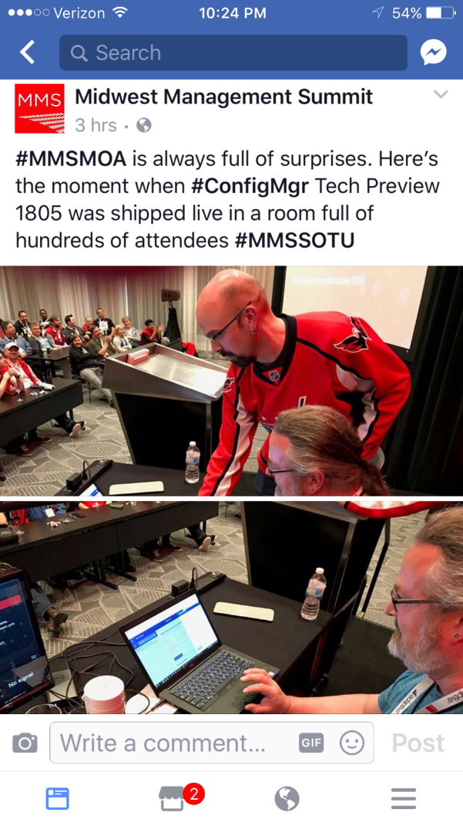
Michigan Medicine
Mike Marable
mmarable@med.umich.edu
Current Environment:
Fleet Size: ~39,000
Desktop / Mobile Ratio: ~ 70/30
WaaS v1 Pilot: September 2018
~450 Machines
Upgraded from 1607 to 1709

Slide 3
Back Story
First In-Place Upgrade attempted in September 2017
Roughly 20 machines
Very low success rate = very high “failure” rate
Most were laptops
Offline at time of deployment
No reporting
No communication
Just dove in and crossed our fingers

Slide 4
Purpose
Learn from what went wrong before
Reduce the failures of In-Place Upgrades at time of deployment
Create a process for reporting of problematic machines that require remediation
Provide desktop support procedures for remediating machines quickly
Automation!
(Still working on this part)

Slide 5
High-Level Process Overview
Pre-Assessment
What do we already know?
PreCache and Compatibility Scan
What can the machine tell us?
In-Place Upgrade
Welcome to the new world.
Pre-Assessment
PreCache and CompatScan
In-Place Upgrade

Slide 6

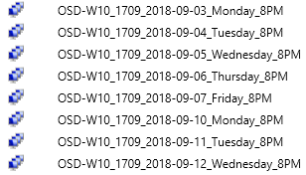
Structure (WIP)
Each phase equates to a collection
Scheduled deployments happen on weeknights

Slide 7
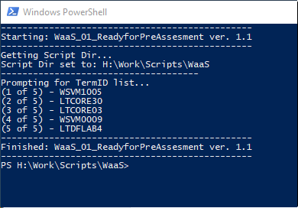
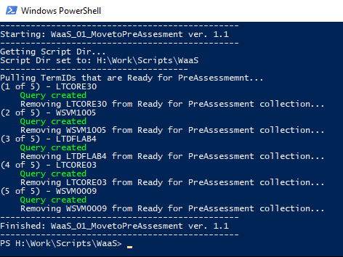
Feeding the Beast
How do we get machines into the process?
Importing Computers
PowerShell script fed by a text file
Added to the “Ready for Pre-Assessment” collection
Ready for Pre-Assessment
Holding collection before beginning the process
Last chance to get off the ride before things get moving
Moving to Pre-Assessment
PowerShell script that moved computers from the “Ready for Pre-Assessment” collation into the first phase of the process

Slide 8

Feeding the Beast: Development
Still maintain the ability to feed in machines from text file lists
Provides the flexibility to slowly trickle in machines at first (i.e. QA Testing, Pilot Groups, Early Adopters, etc.)
Automate bringing in computers en masse
Bring in growing numbers of computers
Group 1 = 10% of the population
Group 2 = 25% of the population
Group 3 = Remaining population

Slide 9
Pre-Assessment
What do we already know?
Goal: Catch problematic machines early on so that they can be remediated prior to the upgrade attempt
Do not touch the machine! Leverage what we already have collected in Configuration Manager.
Test Criteria:
Is the machine running Windows 10?
Is the machine running a prior build of Windows 10?
Is the machine BitLocker compliant?
Is there enough free disk space?
Is the machine current in Configuration Manager?

Slide 10
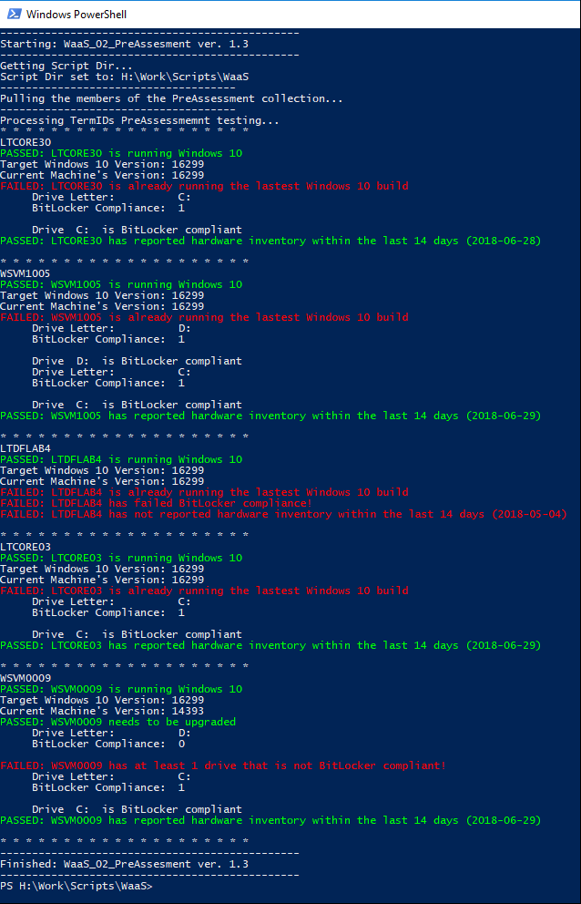
Pre-Assessment: Process
PowerShell Script
Enumerates the Pre-Assessment collection
Queries against ConfigMgr using WMI to perform each test
Each test failure earns 1 “demerit” point
Only those machines with 0 points are moved on to the next phase: PreCache and Compatibility Scan

Slide 11
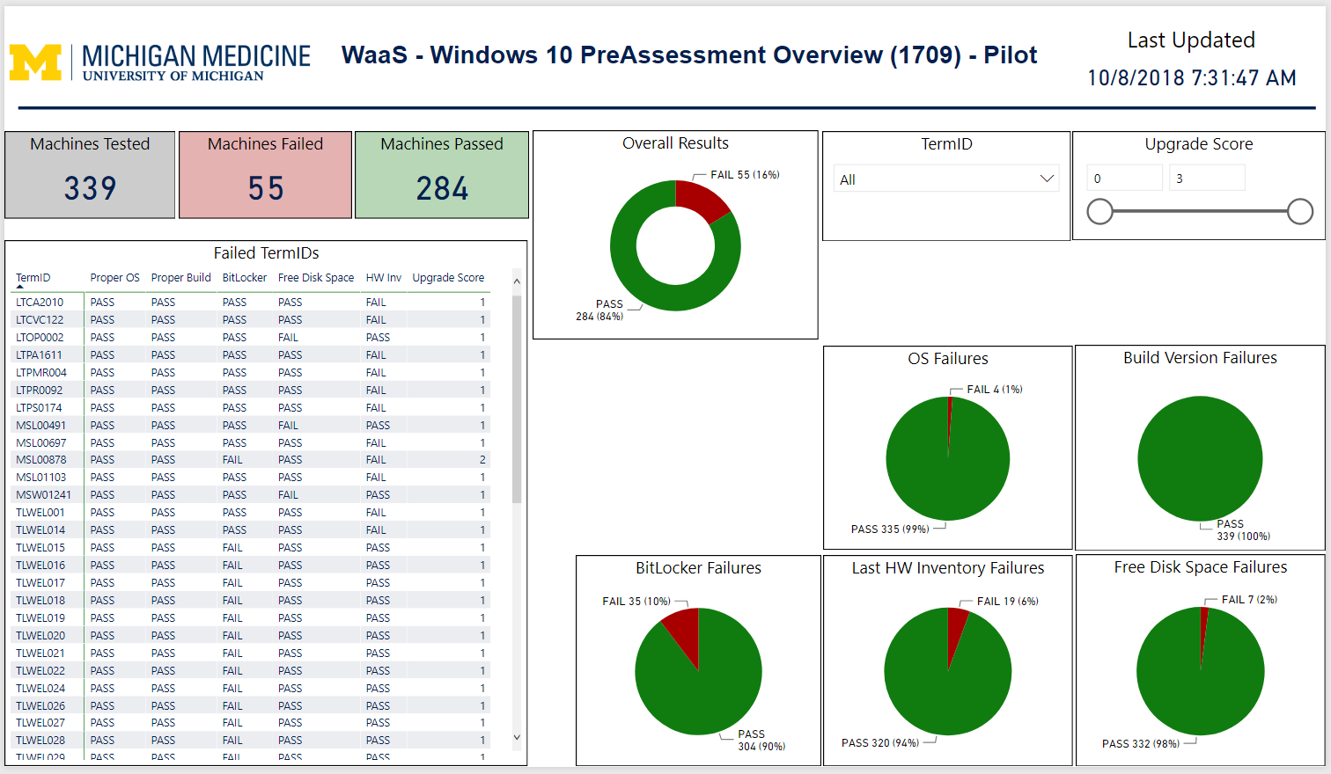
Pre-Assessment: Reporting
Pre-Assessment results are written to CSV files
A Power BI report is used to provide graphic visualization of results

Slide 12
Pre-Assessment: Lessons Learned
How should desktop support be notified of a failed machine?
How should desktop support handle failures?
Can any remediation actions be taken automatically?

Slide 13
Pre-Assessment: Development
Automate addressing Pre-Assessment failures
Process the tests in order of importance and stop processing at first failure
Move failed machines into another collection for remediation
BitLocker failures should be rebuilt
Disk space issues will run a cleanup script/task sequence
Machines not reporting hardware inventory will trigger service tickets for support staff to address
Catch retired/unsupported hardware
Address machines that are no longer going to be supported and need to be replaced

Slide 14
PreCache and Compatibility Scan
What can the machine tell us?
Goals:
Cache the content required for the upgrade onto the machine well in advance
Determine if there are any issues with the machine that will prevent/fail the upgrade
Now we are going to touch the machine.

Slide 15
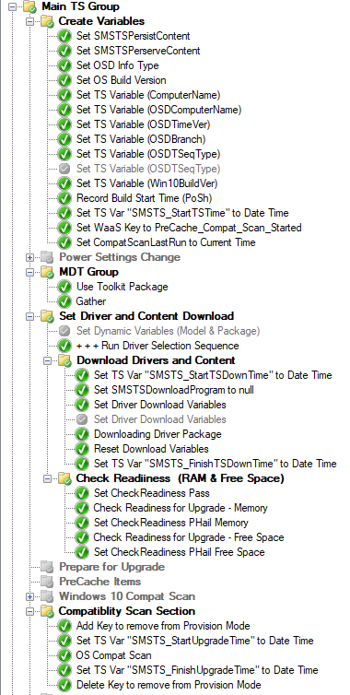
PreCache and Compatibility Scan: Process
A task sequence is used to select and cache the needed driver package and execute the Windows 10 compatibility scan.
The deployment is configured to download ALL content prior to running.
A web service is used to move successful machines on to the next phase: Ready for Scheduling

Slide 16
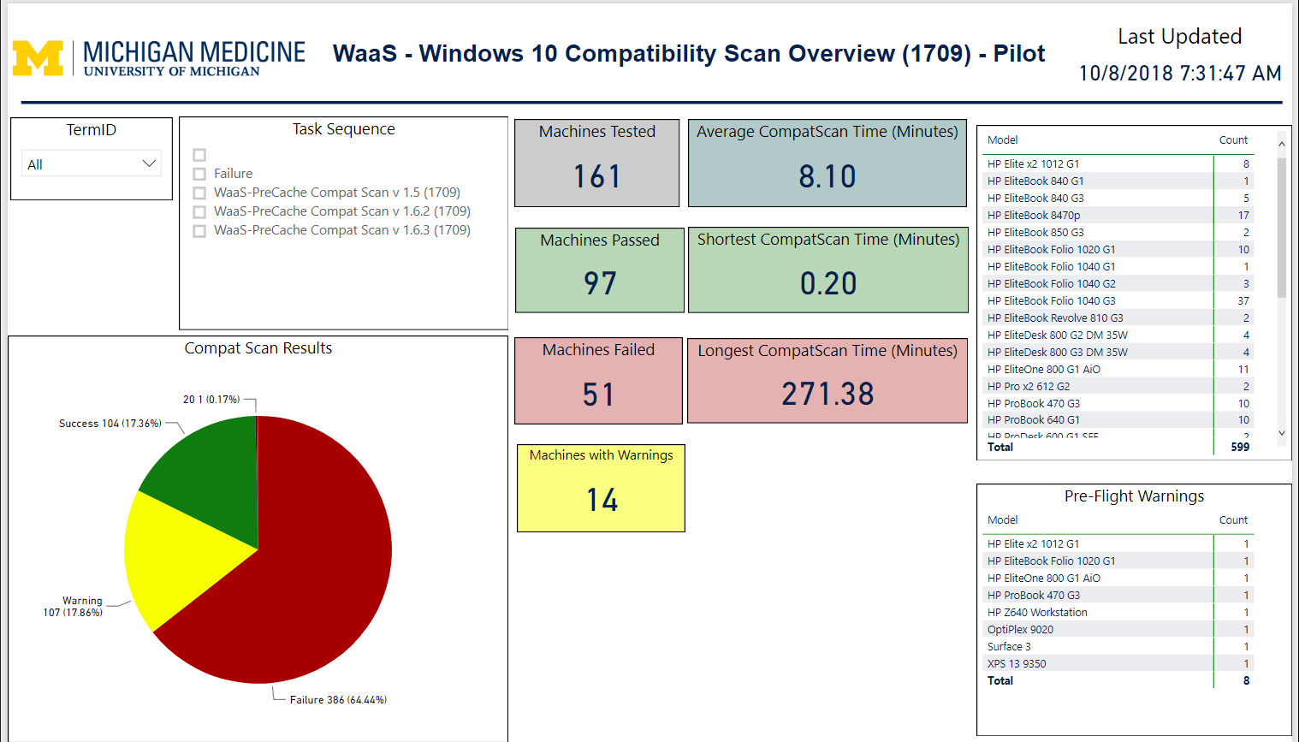
PreCache and Compatibility Scan: Reporting
Results are recorded at the completion of the sequence to a CSV file.
Power BI is used to visualize the results.

Slide 17
PreCache and Compatibility Scan: Lessons Learned
Machines that fail remain in the collection and re-run the sequence, resulting in skewed results.
How should desktop support handle problematic machines?

Slide 18
PreCache and Compatibility Scan: Development
Spread CompatScan deployments across multiple days
Prevents a flood of machines running it at the same time
Scales better
How should failures be addressed?
Pull out of the CompatScan collection (prevents re-running)
Ticket to desktop support?
Can any remediation be automated?

Slide 19
In-Place Upgrade
Welcome to the new world.
Goal: To upgrade the machine to the current Windows 10 build.
Machine has passed all prior tests and now should have the best possible chance at successfully upgrading to the new build.

Slide 20
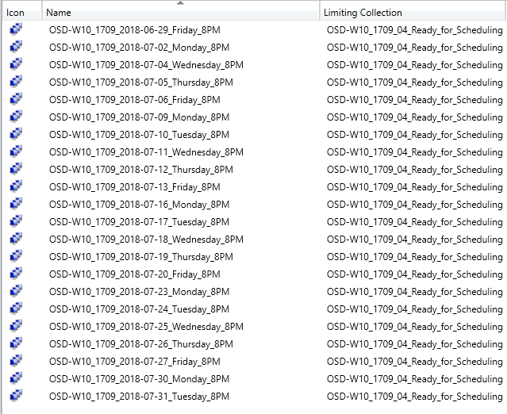
In-Place Upgrade: Progress
Weekdays only
Each day’s collection has a Maintenance Window that allows a task sequence to only execute between 8:00pm and 4:00am.
One deployment per day (8:15pm)
If the IPU is successful, the web service removes the machine from the process.

Slide 21
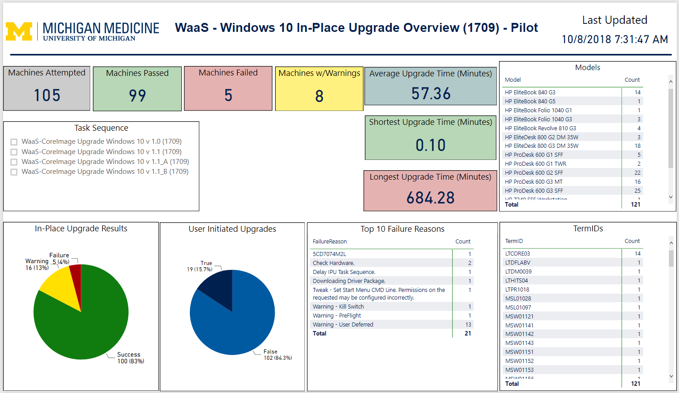
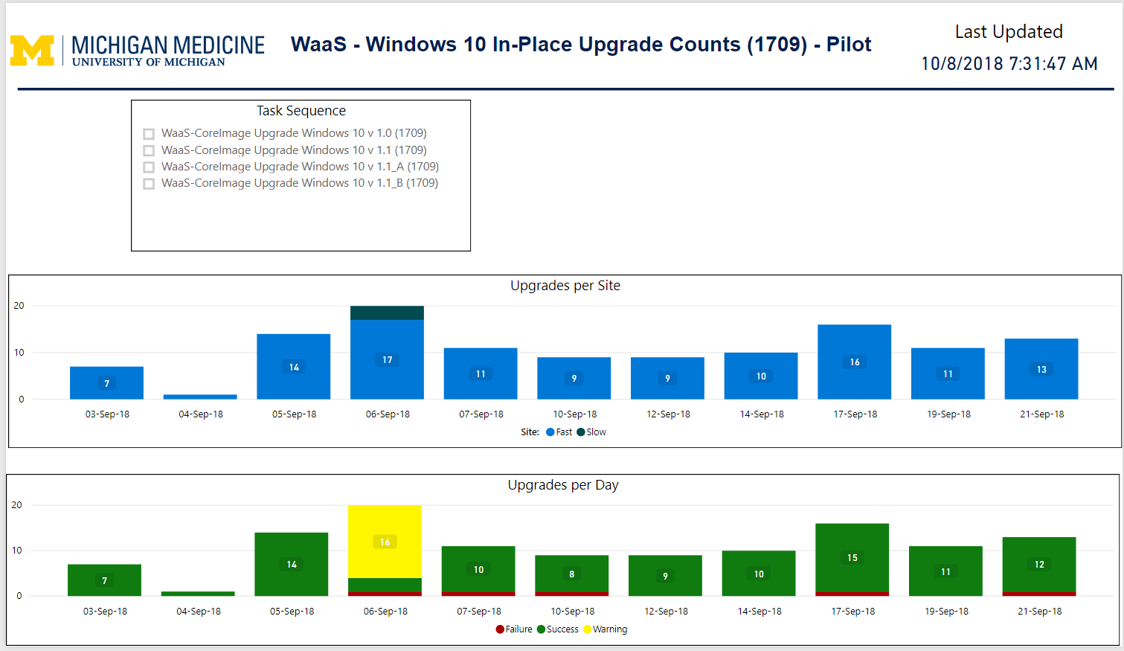
In-Place Upgrade: Reporting
Results are written to a central CSV at the completion of the IPU sequence.
These results are used in a Power BI report.

Slide 22
In-Place Upgrade: Lessons Learned
Upgrading wireless laptops or devices over VPN do not report status or record results at completion, nor do they trigger the web service to remove them from the process.
Manual pull is needed to run outside of scheduled time.
User deferments are needed.

Slide 23
In-Place Upgrade: Development
Switch to using Status Messages and away from the CSVs for reporting
Switch to using Status Messages and away from the web service to move successful machines out of the process
Addresses machines that go offline during the upgrade (i.e. wireless or VPN connected)
Change to a randomized, automated process for scheduling of the upgrade
Avoids requiring support staff manually scheduling the upgrade (does not scale)
Ties into offering users the option to manually execute or defer
Change how IPUs are executed
Add the ability for the user to run it manually outside of the scheduled time
Offer user the ability to defer execution and possibly reschedule at a more convenient time
Automatically add machines that miss scheduled IPU to an aggressive “catch up” deployment
Run during the day
Offer the user the ability to defer or run immediately

Slide 24
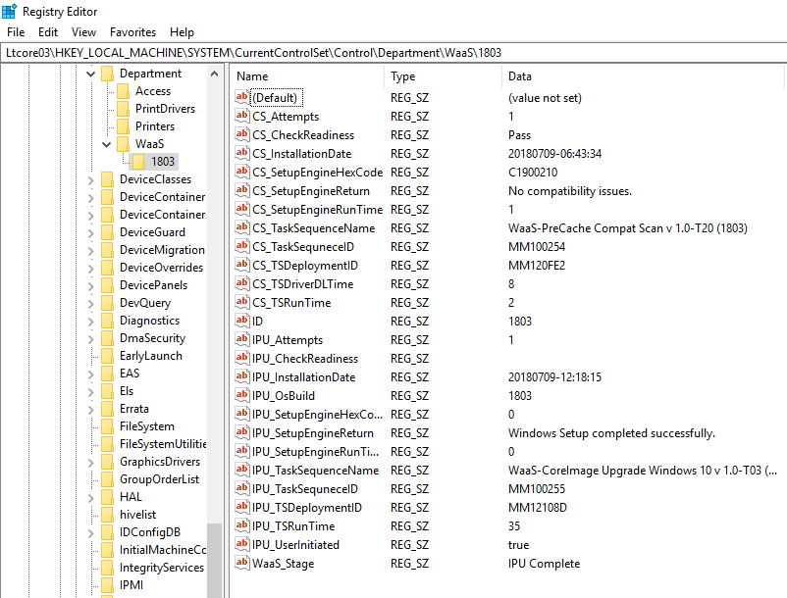
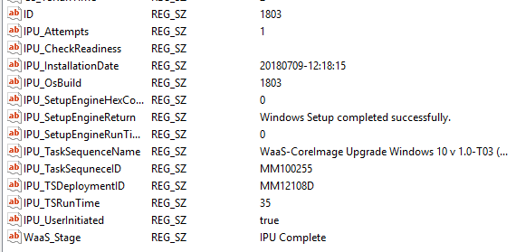
In-Place Upgrade: Development Registry Branding
Investigating the use of Registry branding and collecting the results as part of hardware inventory for reporting and triggers for moving systems through the process.

Slide 25
Reference Info
MMS Session Info:
Windows as a Service in the Enterprise Part 1
Windows as a Service in the Enterprise Part 2
Mike Terrill’s Blog Info
Windows as a Service in the Enterprise Overview Part 1
Gary Blok’s Blog Info
WaaS

Slide 26
Questions?

